Slide 1
C206 L10 Part B
Sprint Execution II – Test-Driven Development II

Slide 2
The Scrum Framework
Processes of Scrum Framework
Product Backlog Grooming
Sprint Planning
Sprint Execution
Test-Driven Development (TDD)
Daily Scrum
Code Refactoring
Code Review
Sprint Review
Sprint Retrospective
Lesson 9
Lesson 10
Lesson 10 and 11
Lesson 11 Part A
Lesson 11 Part B
Lesson 12 Part A
Lesson 12 Part B

Slide 3
C206 L10 Part B Learning objectives
Sprint Execution
Daily Scrum / Stand-up meeting (Day 2)
Test-Driven Development (continue)
Setting up of GitHub for team collaboration

Slide 4

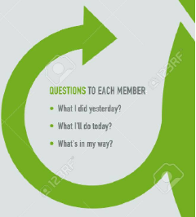
Daily Scrum/Stand-up meeting (10 min)
Assume now is the second day of the sprint.
Perform daily stand-up meeting
Update Sprint Backlog and Burndown Chart
3 questions to each member
What did you do yesterday?
What will you do today?
Are there any impediments in your way?

Slide 5
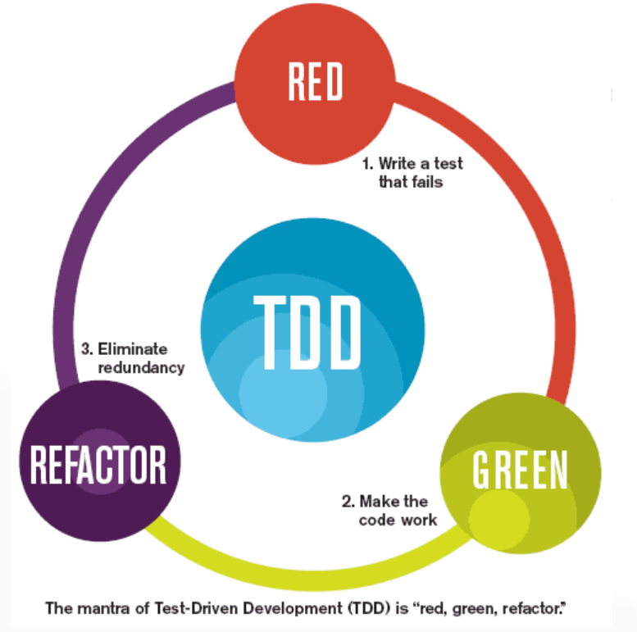
Test Driven Development

Slide 6
Hands on activity - TDD for User Story 6 (45 min)
Perform TDD process to develop the User Story 6 (US_06).
User Story 6
As a Resource Centre staff member, I want to be able to input loan details for laptops and digital cameras, including the student's name, asset number of the item, and due date, so that I can easily track the loan records.
Given that a staff member inputs loan details for laptops and digital cameras, when the system successfully records the loan details, then the staff member can easily track the loan records.
Acceptance Criteria:
The system should allow the staff member to input loan details for both laptops and digital cameras.
The staff member should be able to input the asset number of the item, and due date.
The system should validate that the asset number entered corresponds to a laptop or digital camera in the inventory.
The system should not allow loan details to be entered for an item that is already checked out.
The staff member should receive a confirmation message after the loan details are successfully recorded.

Slide 7
Hands on activity - TDD for User Story 7 (45 min)
Perform TDD process to develop the User Story 7 (US_07).
User Story 7
As a Resource Centre staff member, I want to be able to mark an item as checked in when a student returns it, so that I can keep accurate loan records.
Given that a student returns a loaned item, when a Resource Centre staff member marks it as checked in, then the loan record is updated to reflect the return date and the item is made available for loan again.
Acceptance Criteria:
The staff member can select the option to mark an item as checked in.
The staff member enters the asset number and confirms the return.
The loan record is updated to reflect the return date of the item.
The item is made available for loan again.

Slide 8
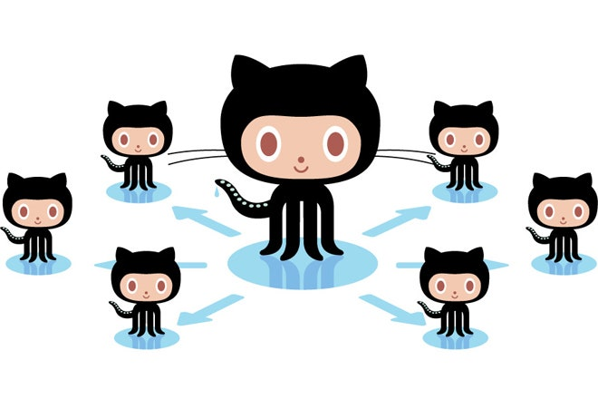
Version Control and GitHub

Slide 9
Version Control and GitHub (Recap)
Version Control is the process of managing changes to computer programs, documents, and other collections of information, enabling tracking of individual versions and changes over time.
Essential for software development, particularly for team collaborations
Helps prevent conflicts when multiple people work on the same project
GitHub is a web-based Git version control repository hosting service, but with many other features such as a wiki and basic task management

Slide 10
Setting up ResourceCentre project in GitHub
Team leader (or the student with the completed codes) push the project ResourceCentre_XXXXXXXX into GitHub.
Team leader add other team members into the project as collaborators.
Other team members pull/import the project from GitHub.
Refer to “Using VS Code with GitHub in a team file” in the User Guides folder for the steps needed to perform the above actions.

Slide 11
Summary
Daily Scrum/stand up meeting for Day 2
Continue with the Test-Driven Development (TDD)
Set up GitHub for team collaboration
to be used in next lesson

